Slide 1
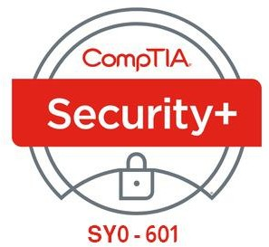

07- Implementing Authentication Controls
Ehab Fahmi
Senior Cyber Security Consultant - Instructor

Slide 2
Outlines
7.1- Summarize Authentication Design Concepts
7.2- Implement Knowledge-Based Authentication
7.3- Summarize Biometrics Authentication Concepts

Slide 3
7.1- Summarize Authentication Design Concepts
7.2- Implement Knowledge-Based Authentication 7.3- Summarize Biometrics Authentication Concepts

Slide 4
IDENTITY AND ACCESS MANAGEMENT
An access control system is the set of technical controls that govern how subjects
may interact with objects.
Subjects in this sense are users, devices, or software processes, or anything else
that can request and be granted access to a resource.
Objects are the resources; these could be networks, servers, databases, files, and so on.

Slide 5
IDENTITY AND ACCESS MANAGEMENT (cont.)
An identity and access management (IAM) system is usually described in terms of four main processes:
Identification—creating an account or ID that uniquely represents the user, device, or process on the network.
Authentication—proving that a subject is who or what it claims to be when it attempts to access the resource.
Authorization—determining what rights subjects should have on each resource, and enforcing those rights.
Accounting—tracking authorized usage of a resource or use of rights by a subject and alerting when unauthorized use is detected or attempted.

Slide 6
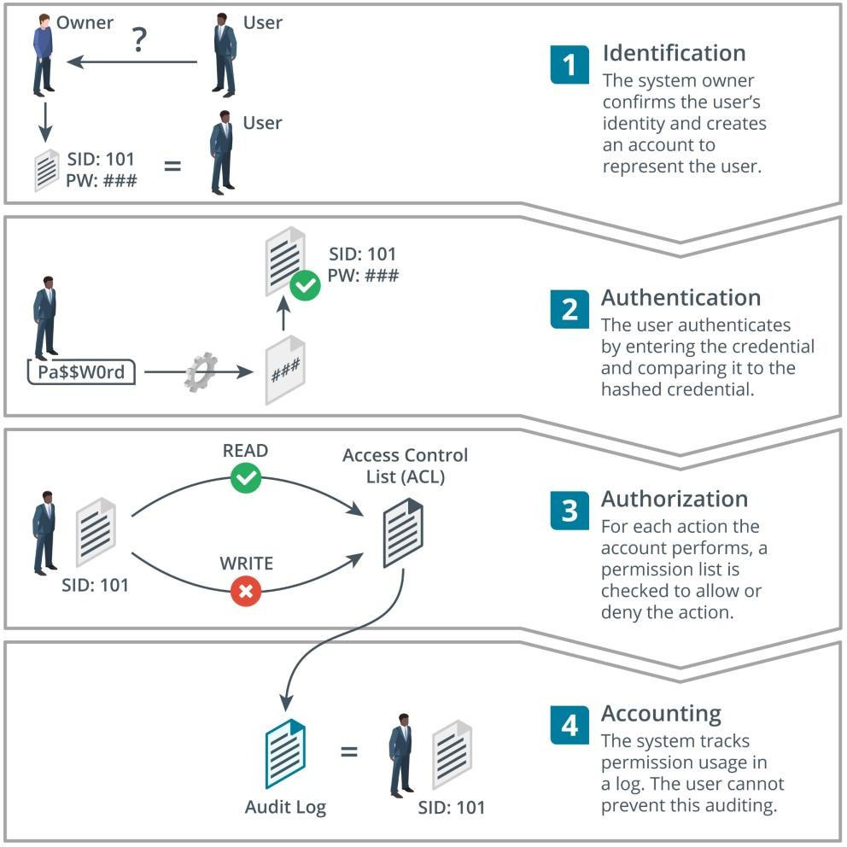
IDENTITY AND ACCESS MANAGEMENT (cont.)

Slide 7
AUTHENTICATION FACTORS
Assuming that an account has been created securely (the identity of the account holder has been verified), authentication verifies that only the account holder is able to use the account, and that the system may only be used by account holders.
Authentication is performed when the account holder supplies the appropriate credentials (or authenticators) to the system.
These are compared to the credentials stored on the system.
If they match, the account is authenticated.
There are many different technologies for defining credentials and can be categorized as factors.

Slide 8
AUTHENTICATION FACTORS (cont.)
Something You Know Authentication
The typical knowledge factor is the logon, composed of a username and a password.
The username is typically not a secret (although it should not be published openly), but the password must be known only to the account holder.
A personal identification number (PIN) is also something you know, although long PIN codes are hard to remember, and short codes are too vulnerable for most authentication systems.
Swipe patterns are often used for authentication to touch-based devices.

Slide 9
AUTHENTICATION FACTORS (cont.)
Something You Have Authentication
An ownership factor means that the account holder possesses something that no one else does, such as a smart card, fob, or wristband programmed with a unique identity certificate or account number.
These ownership factors can be described as hard tokens.
A device such as a smartphone can also be used to receive a uniquely generated access code as a soft token.
Unlike a password, these tokens are valid for only one use, typically within a brief time
window.

Slide 10
AUTHENTICATION FACTORS (cont.)
Something You Are/Do Authentication
A biometric factor uses either physiological identifiers, such as a fingerprint, or behavioral identifiers, such as the way someone moves (gait).
The identifiers are scanned and recorded as a template.
When the user authenticates, another scan is taken and compared to the template.

Slide 11
AUTHENTICATION DESIGN
Authentication design refers to selecting a technology that meets requirements for confidentiality, integrity, and availability:
Confidentiality, in terms of authentication, is critical, because if account credentials are leaked, threat actors can impersonate the account holder and act on the system with whatever rights they have.
Integrity means that the authentication mechanism is reliable and not easy for threat actors to bypass or trick with counterfeit credentials.
Availability means that the time taken to authenticate does not impede workflows and is easy enough for users to operate.

Slide 12
MULTIFACTOR AUTHENTICATION
An authentication technology is considered strong if it combines the use of more than one type of knowledge, ownership, and biometric factor, and is called multifactor authentication (MFA).
Single-factor authentication can quite easily be compromised: a password could be written down or shared, a smart card could be lost or stolen, and a biometric system could be subject to high error rates or spoofing.
Two-Factor Authentication (2FA) combines either an ownership-based smart card or biometric identifier with something you know, such as a password or PIN.

Slide 13
MULTIFACTOR AUTHENTICATION (cont.)
Three-factor authentication combines all three technologies, or incorporates an additional attribute, such as location; for example, a smart card with integrated fingerprint reader.
This means that to authenticate, the user must possess the card, the user's fingerprint must match the template stored on the card, and the user must input a PIN or password.

Slide 14
7.1- Summarize Authentication Design Concepts
7.2- Implement Knowledge-Based Authentication
7.3- Summarize Biometrics Authentication Concepts

Slide 15
LOCAL, NETWORK, AND REMOTE AUTHENTICATION
One of the most important features of an operating system is the authentication provider, which is the software architecture and code that underpins the mechanism by which the user is authenticated before starting a shell.
This is usually described as a login (Linux) or a logon or sign-in (Microsoft).
Knowledge-based authentication, using a password or personal identification number (PIN), is the default authentication provider for most operating systems.

Slide 16
Windows Authentication
Windows authentication involves a complex architecture of components (docs.microsoft.com/en-us/windows-server/security/windows- authentication/credentials-processes-in-windows-authentication), but the following three scenarios are typical:
Windows local sign-in—the Local Security Authority (LSA) compares the submitted credential to a hash stored in the Security Accounts Manager (SAM) database, which is part of the registry.
Windows network sign-in—the LSA can pass the credentials for authentication to a network service, The preferred system for network authentication is based on Kerberos, but legacy network applications might use NT LAN Manager (NTLM) authentication.
Remote sign-in—if the user's device is not connected to the local network, authentication can take place over some type of virtual private network (VPN) or web portal.

Slide 17
Linux Authentication
In Linux, local user account names are stored in /etc/passwd.
When a user logs in to a local interactive shell, the password is checked against a hash stored in /etc/shadow.
Interactive login over a network is typically accomplished using Secure Shell (SSH).
With SSH, the user can be authenticated using cryptographic keys instead of a password.

Slide 18
Single Sign-On (SSO)
A single sign-on (SSO) system allows the user to authenticate once to a local device and be authenticated to compatible application servers without having to enter credentials again.
In Windows, SSO is provided by the Kerberos framework.

Slide 19
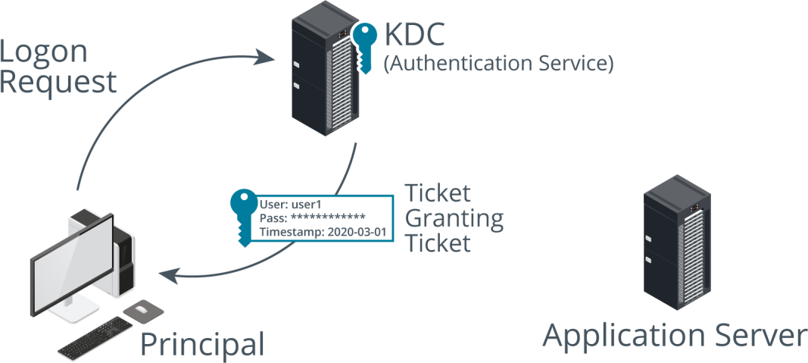
KERBEROS AUTHENTICATION
Kerberos is a single sign-on network authentication and authorization protocol used on many networks, notably as implemented by Microsoft's Active Directory (AD) service.
Kerberos was named after the three-headed guard dog of Hades (Cerberus) because it consists of three parts.

Slide 20
KERBEROS AUTHENTICATION (cont.)
The client sends the authentication service (AS) a request for a Ticket Granting Ticket (TGT), This is composed by encrypting the date and time on the local computer with the user's password hash as the key.
The AS checks that the user account is present, that it can decode the request by matching the user's password hash with the one in the Active Directory database, and that the request has not expired, If the request is valid, the AS responds with the following data:
Ticket Granting Ticket (TGT)—this contains information about the client (name and IP address) plus a timestamp and validity period, This is encrypted using the KDC's secret key.
TGS session key for use in communications between the client and the Ticket Granting Service (TGS), This is encrypted using a hash of the user's password.

Slide 21
PASSWORD ATTACKS
When a user chooses a password, the password is converted to a hash using a cryptographic function, such as MD5 or SHA.
This means that, in theory, no one except the user (not even the system administrator) knows the password, because the plaintext should not be recoverable from the hash.

Slide 22
PASSWORD ATTACKS (cont.)
Plaintext/Unencrypted Attacks
A plaintext/unencrypted attack exploits password storage or a network authentication
protocol that does not use encryption.
Examples include PAP, basic HTTP/FTP authentication, and Telnet.
These protocols must not be used.
Passwords must never be saved to an unmanaged file.
One common source of credential breaches is passwords embedded in application code that
has subsequently been uploaded to a public repository.

Slide 23
PASSWORD ATTACKS (cont.)
Online Attacks
An online password attack is where the threat actor interacts with the authentication service directly—a web login form or VPN gateway, for instance.
The attacker submits passwords using either a database of known passwords (and variations) or a list of passwords that have been cracked offline.
Also, be aware that there are databases of username and password/password hash combinations for multiple accounts stored across the Internet.
These details derive from successful hacks of various companies' systems.
These databases can be searched using a site such as haveibeenpwned.com.

Slide 24
PASSWORD ATTACKS (cont.)
Offline Attacks
An offline attack means that the attacker has managed to obtain a database of password hashes, such as %SystemRoot%\System32\config\SAM, %SystemRoot%\NTDS\NTDS.DIT (the Active Directory credential store), or /etc/shadow.
Once the password database has been obtained, the cracker does not interact with the authentication system.
The only indicator of this type of attack (other than misuse of the account in the event of a successful attack) is a file system audit log that records the malicious account accessing one of these files.

Slide 25
BRUTE-FORCE AND DICTIONARY ATTACKS
Some password attacks exploit the weak credentials chosen by users.
Others can exploit vulnerabilities in the storage mechanism.
For Example:
The Windows SAM database can be configured to store hashes for compatibility with older versions (LM and NTLMv1 hashes).
These legacy hashes are cryptographically weak and highly vulnerable to password cracking.

Slide 26
Brute-Force Attack
A brute-force attack attempts every possible combination in the output space in order to match a captured hash and guess at the plaintext that generated it.
The output space is determined by the number of bits used by the algorithm
(128-bit MD5 or 256-bit SHA256, for instance).
The larger the output space and the more characters that were used in the plaintext password, the more difficult it is to compute and test each possible hash to find a match.
Brute-force attacks are heavily constrained by time and computing resources, and are therefore most effective at cracking short passwords.
However, brute-force attacks distributed across multiple hardware components, like a cluster of high-end graphics cards, can be successful at cracking longer passwords.

Slide 27
Dictionary and Rainbow Table Attacks
Dictionary attack
can be used where there is a good chance of guessing the likely value of the plaintext, such as
a non-complex password.
The software generates hash values from a dictionary of plaintexts to try to match one to a captured hash.
Rainbow table
The attacker uses a precomputed lookup table of all possible passwords and their matching
hashes.
Not all possible hash values are stored, as this would require too much memory.
Values are computed in chains, and only the first and last values need to be stored.
The hash value of a stored password can then be looked up in the table and the corresponding plaintext discovered.

Slide 28
Dictionary and Rainbow Table Attacks (cont.)
Using a salt to add a random value to the stored plaintext helps to slow down rainbow table attacks, because the tables cannot be created in advance and must be recreated for each combination of password and salt value.
Rainbow tables are also impractical when trying to discover long passwords (more than about 14 characters).
UNIX and Linux password storage mechanisms use salt, but Windows does not.
Consequently, in a Windows environment, it is even more important to enforce
strong password policies.

Slide 29
PASSWORD CRACKERS
Although there are some Windows tools, including the infamous Cain and L0phtcrack (l0phtcrack.com) tools, most password crackers run primarily on Linux.
For example, a tool such as Hashcat (hashcat.net/hashcat) is run using the
following general syntax:
hashcat -m HashType -a AttackMode -o OutputFile InputHashFile
The input file should contain hashes of the same type, using the specified format (hashcat.net/wiki/doku.php?id=example_hashes).
Hashcat can be used with a single word list (dictionary mode -a 0) or multiple word lists (combinator mode -a 1).

Slide 30
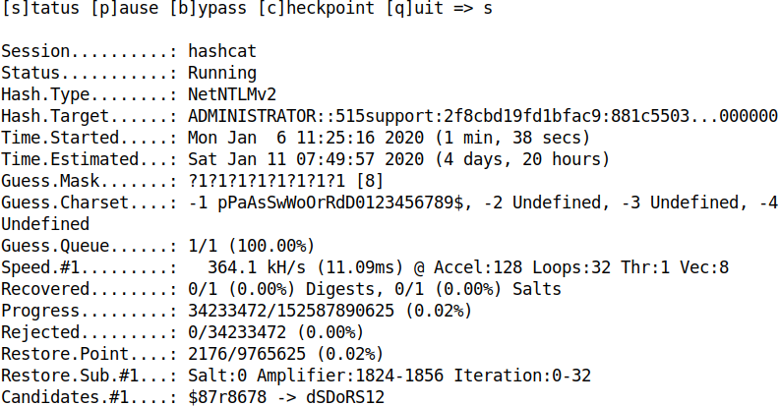
PASSWORD CRACKERS (cont.)

